Slide 1
Course Title: Reward Management
Resource Person
Dr. Saqib Rehman

Slide 2
Lecture Plan
First Half
An Overview of HRM
Second Half
Fundamentals of
Reward Management

Slide 3
Human Resource Management
“HRM is the function performed in organizations that facilitates the most effective use of people to achieve organizational and individual goals.”
Ivancevich and Glueck

Slide 4
Hard and Soft HRM
Hard (instrumental) HRM approach:
employees are viewed as a passive factor of production, an expense
employees can be easily replaced and seen as disposable.
Strategic, quantitative aspects of managing HRM as an economic factor
Soft (humanistic) HRM approach:
stresses active employee participation
gains employee commitment, adaptability and contribution of their competences to achievement of organizational goals
employees are valued as assets
emphasizing communication, motivation and leadership

Slide 5
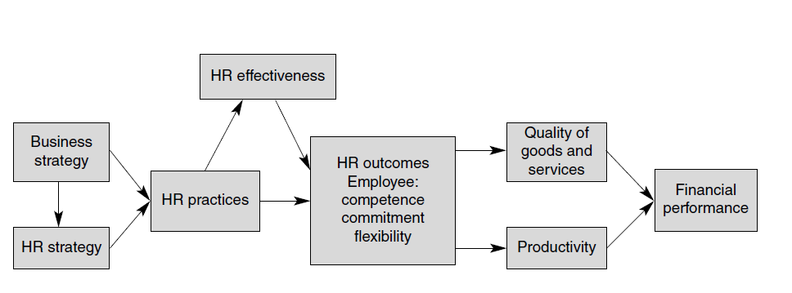
The link between HRM and firm performance

Slide 6
HRM Activities
HR Planning
Job Analysis and Design
Recruitment and Selection
Training and Development
Compensation & Remuneration
Performance Management
Rewards Management
Career Development
Welfare
Safe and Healthy Work Environment
Industrial relations

Slide 7
Reward Management
Definition
Reward management deals with the strategies, policies and processes required to ensure that the contribution of people to the organization is recognized by both financial and non-financial means.
Reward management is not just about pay and employee benefits. It is equally concerned with non-financial rewards such as recognition, learning and development opportunities and increased job responsibility.

Slide 8
THE AIMS OF REWARD MANAGEMENT
The aims of reward management are to:
reward people according to the value they create;
align reward practices with business goals and with employee values and needs;
reward the right things to convey the right message about what is important in terms of behaviours and outcomes;
help to attract and retain the high-quality people the organization needs;
motivate people and obtain their engagement and commitment;
develop a high-performance culture.

Slide 9
Reward Philosophy
a set of beliefs and guiding principles that are consistent with the values of the organization and help to enact them.
The philosophy recognizes that, if human resource management (HRM) is about investing in human capital from which a reasonable return is required, then it is proper to reward people differentially according to their contribution

Slide 10
Elements of Reward System
Areward system consists of:
● Policies that provide guidelines on approaches to managing rewards.
● Practices that provide financial and non-financial rewards.
● Processes concerned with evaluating the relative size of jobs (job evaluation) and assessing individual performance (performance management).
● Procedures operated in order to maintain the system and to ensure that it operates efficiently and flexibly and provides value for money.

Slide 11
Considerations of Rewards
Distributive justice
As defined by Leventhal (1), distributive justice refers to how rewards are provided to people. They will feel that they have been treated justly if they believe that the rewards have been distributed in accordance with the value of their contribution, that they receive what was promised to them and that they get what they need.

Slide 12
Considerations of Rewards
Procedural justice
Procedural justice refers to the ways in which managerial decisions are made and reward policies are put into practice.

Slide 13
Considerations of Rewards
Fairness
A fair reward system is one that operates in accordance with the principles of distributive and procedural justice. It also conforms to the ‘felt-fair’ principle formulated by Eliot Jaques. This states that pay systems will be fair if they are felt to be fair.

Slide 14
Considerations of Rewards
Equity
Equity is achieved when people are rewarded appropriately in relation to others within the organization. Equitable reward processes ensure that relativities between jobs are measured as objectively as possible and that equal pay is provided for work of equal value.

Slide 15
Considerations of Rewards
Consistency
A consistent approach to reward management means that decisions on pay do not vary arbitrarily – without due cause – between different people or at different times. They do not deviate irrationally from what would generally be regarded as fair and Equitable.

Slide 16
Considerations of Rewards
Transparency
Transparency exists when people understand how reward processes function and how they are affected by them. The reasons for pay decisions are explained at the time they are made. Employees have a voice in the development of reward policies and practices.

Slide 17
Considerations of Rewards
Strategic alignment
The strategic alignment of reward practices ensures that reward initiatives are planned by reference to the requirements of the business strategy and are designed to support the achievement of business goals.
Contextual and culture fit
The design of reward processes should be governed by the context (the characteristics of the organization, its business strategy and the type of employees) and the organization’s culture (its values and behavioural norms). Account should be taken of good practice elsewhere, but this should not be regarded as best practice, ie universally applicable. Best fit is more important than best practice.
Fit for purpose
The formulation of reward strategy and the design of the reward system should be based on an understanding of the objectives of reward management and should be developed to achieve that purpose.

Slide 18
Considerations of Rewards
Strategic alignment
The strategic alignment of reward practices ensures that reward initiatives are planned by reference to the requirements of the business strategy and are designed to support the achievement of business goals.
Contextual and culture fit
The design of reward processes should be governed by the context (the characteristics of the organization, its business strategy and the type of employees) and the organization’s culture (its values and behavioural norms). Account should be taken of good practice elsewhere, but this should not be regarded as best practice, ie universally applicable. Best fit is more important than best practice.
Fit for purpose
The formulation of reward strategy and the design of the reward system should be based on an understanding of the objectives of reward management and should be developed to achieve that purpose.

